Slide 1



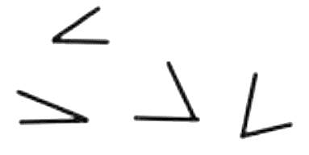

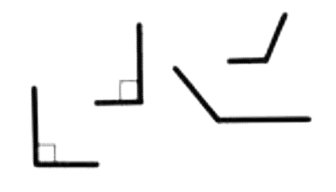

















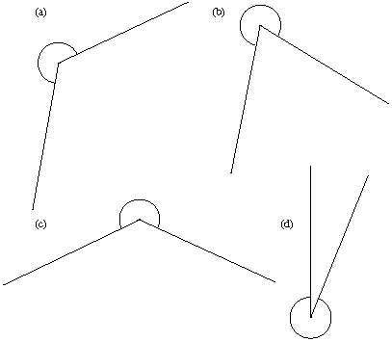


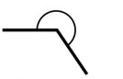





Subtopic G1.1 – Types of angles and notation
LEARNING OUTCOME: To be able to understand angles, lines and their notation
Objectives:
Keywords:
- Acute
- Obtuse
- Reflex
- Right-angle
- Parallel
- Perpendicular
To be able to identify different angle types.
To be able to understand angle and line notation.
To be able to understand angles as turns
To be able to identify and describe parallel and perpendicular lines
Definition
Characteristics
Smaller than a right-angle
Examples
Acute Angle
Non - Examples
Definition
Characteristics
Greater than a right-angle, but smaller than the angle on a straight line.
Examples
Obtuse Angle
Non - Examples
Definition
Characteristics
Greater than the angle on a straight line, but less than the angle around a point.
Examples
Reflex Angle
Non - Examples

Slide 2

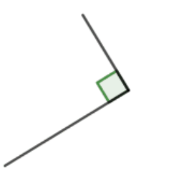

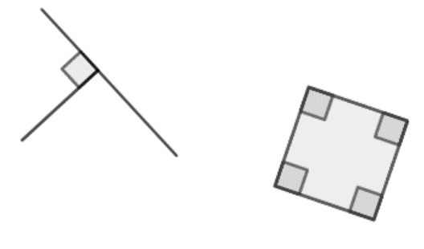

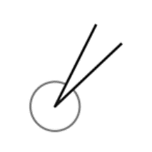
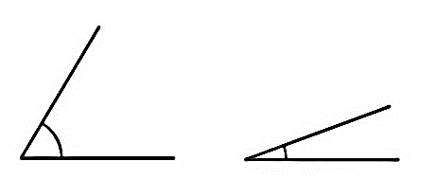


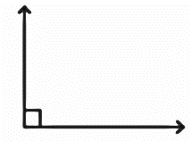

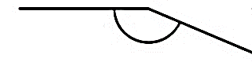


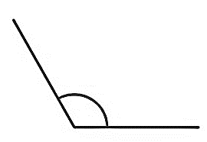
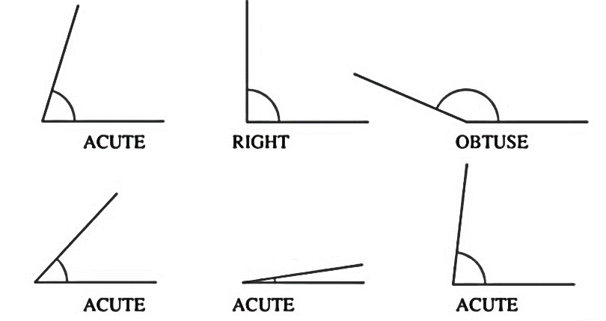
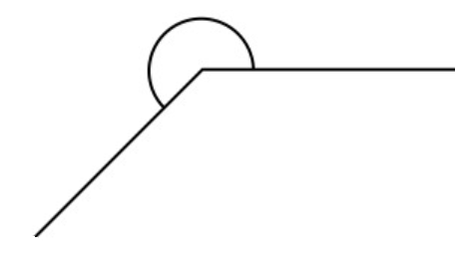
Definition
Characteristics
Shown with this symbol
Examples
Right Angle
Non - Examples
Identifying types of angles
 | Example 1 – I do… | Example 2 – We do… | Example 3 – You do…
Steps | Name each angle below as acute, obtuse, right or reflex: | Name each angle below as acute, obtuse, right or reflex: | Name each angle below as acute, obtuse, right or reflex:
 | a) | a) | a)
 | b) | b) | b)
 | d) | d) | d)
Acute
Acute
Reflex
Obtuse
Reflex
Right angle
Reflex
Obtuse
Right angle
Acute
Obtuse
Reflex

Slide 3
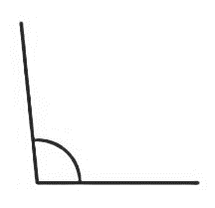
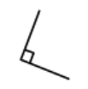

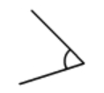


Independent Practice
Question 1. True or false? Circle the correct answer.
a) The following angle is acute. |  | b) The following angle is acute.
 | True/ False |  | True/ False
c) The following angle is acute. |  | d) The following angle is acute.
 | True/ False |  | True/ False
e) The following angle is acute. |  | f) The following angle is acute.
 | True/ False |  | True/ False
g) The following angle is obtuse. |  | h) The following angle is obtuse.
 | True/ False |  | True/ False
i) The following angle is obtuse. |  | j) The following angle is obtuse.
 | True/ False |  | True/ False
k) The following angle is obtuse. |  | l) The following angle is obtuse.
 | True/ False |  | True/ False

Slide 4
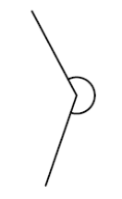
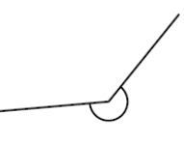
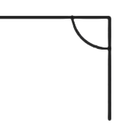
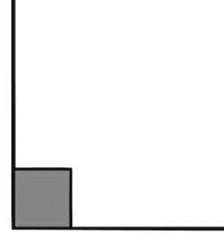
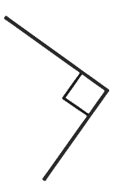
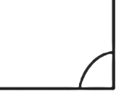
Question 1 continued.
m) The following angle is a reflex angle. |  | n) The following angle is a reflex angle.
 | True/ False |  | True/ False
o) The following angle is a reflex angle. |  | p) The following angle is a reflex angle.
 | True/ False |  | True/ False
q) The following angle is a right angle. |  | r) The following angle is a right angle.
 | True/ False |  | True/ False
s) The following angle is a right angle. |  | t) The following angle is a right angle.
 | True/ False |  | True/ False
u) The following angle is a right angle. |  | v) The following angle is a right angle.
 | True/ False |  | True/ False
Question 2. Circle the word that makes each statement correct:
a) | An obtuse angle is bigger than an _________ angle. | Acute / Reflex
b) | A _________ angle is smaller than an obtuse angle. | Right / Reflex
c) | A _________ angle is bigger than an obtuse angle. | Right / Reflex
d) | An _________ angle is smaller than a right angle. | Acute / Obtuse

Slide 5
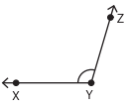

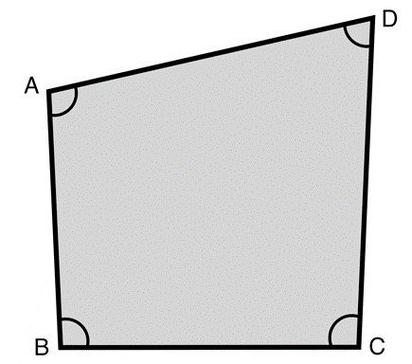



Angle and Line Notation
 | Example 4 – I do… | Example 5 – We do… | Example 6 – You do…
Steps | a) Name the line identified by the dotted line, using correct notation. | a) Name the line identified by the dotted line, using correct notation. | a) Name the line identified by the dotted line, using correct notation.
1) Identify the two points connected by the line. Write these points in alphabetical order.
 | b) Name the line identified by the dotted line, using correct notation. | b) Name the line identified by the dotted line, using correct notation. | b) Name the line identified by the dotted line, using correct notation.
 | c) Name the angle below, using correct notation. | c) Name the angle identified by the arrow below, using correct notation. | c) Name the angle below, using correct notation.
XY
YZ
MN
BC
AD
CD

Slide 6
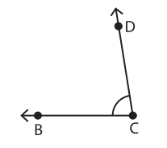
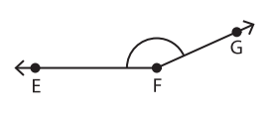
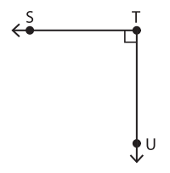
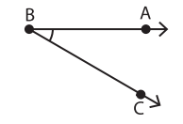
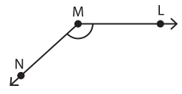
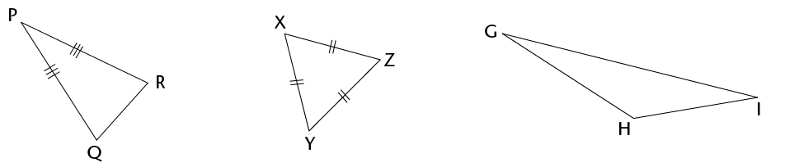
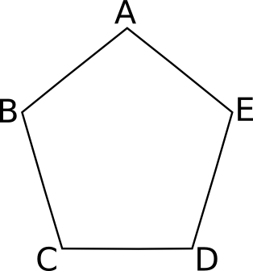
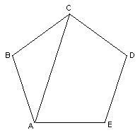
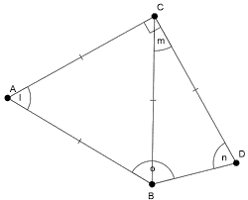
Independent Practice
Question 3. Name the line identified by the dotted line, using correct notation.
a) | b) | c)
d) | e) | f)
g) | h) | i)
j) | k) | l)
BC
CD
FG
EF
ST
TU
AB
BC
LM
GH
YZ
DE
m) | n)
AC
BC

Slide 7














Question 4. Name each angle identified below, using correct notation. Where there are two of the same, use both possible notations.
a) | b) | c)
d) | e) | f)
T
R
S
g) | h) | i)
j) | k) | l)
m) | n)

Slide 8
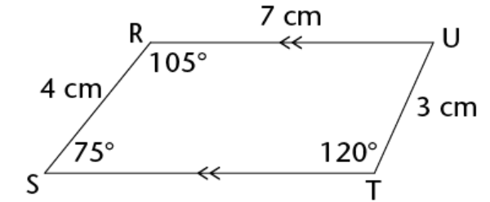
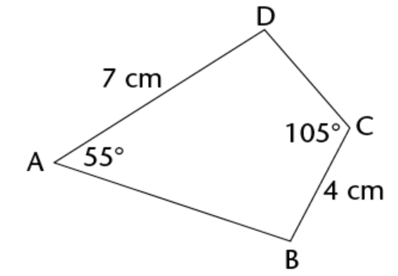


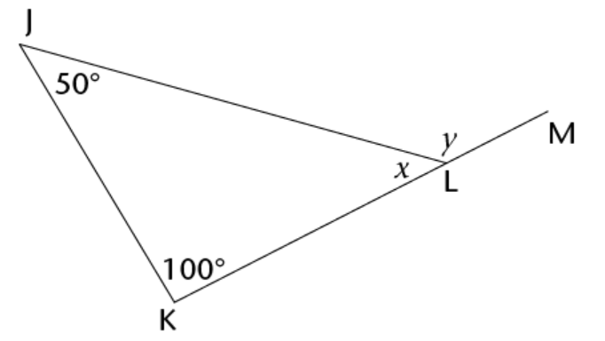
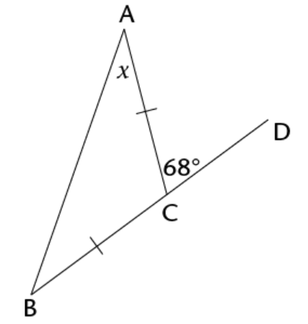


5. Consider the following parallelogram. | 6. Consider the following quadrilateral.
7. Consider the following triangle. | 8. Consider the following isosceles triangle.
4cm
60º
100º
8cm
3cm
7cm
4cm
55º
150º
2cm
30º
112º
50º
5cm

Slide 9
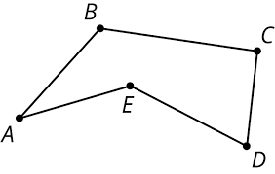





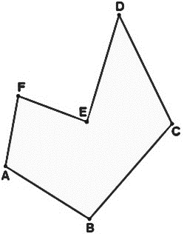


Identifying types of angles in shapes
 | Example 7 – I do… | Example 8 – We do… | Example 9 – You do…
Steps | Mark the two acute angles in the pentagon below, then use correct angle notation to describe them. | Mark the reflex angle in the pentagon below, then use correct angle notation to describe it. | Mark the two obtuse angles in the pentagon below, then use correct angle notation to describe them.
Independent Practice
Question 9. Answer the following questions:
a) Mark any acute angles in the hexagon below, then use correct angle notation to describe them.

Slide 10
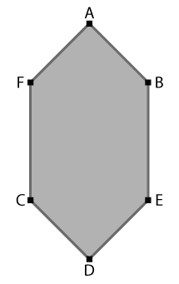



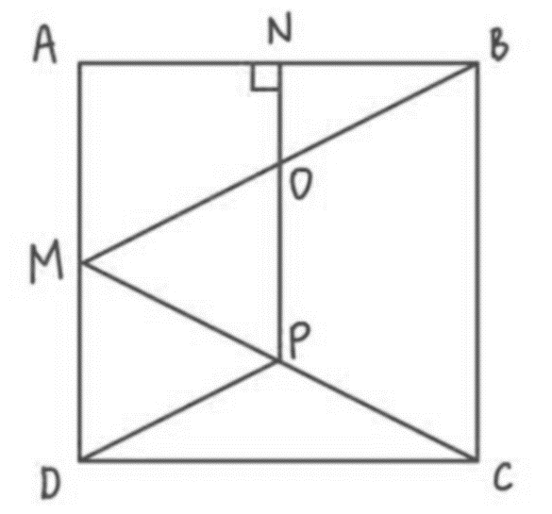


















b) Mark any acute angles in the hexagon below, then use correct angle notation to describe them.
c) Mark any acute angles in the square below, then use correct angle notation to describe them.
d) Mark any right angles in the square below, then use correct angle notation to describe them.

Slide 11




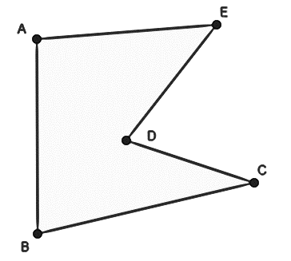
e) Mark any obtuse angles in the square below, then use correct angle notation to describe them.
The following questions refer to the shape below:
f) Write down the two lines that meet to form the reflex angle.
ED and CD
g) Write down the line that meets AB to form an obtuse angle.
AE
h) Write down the line that meets ED to form an acute angle.
AE

Slide 12
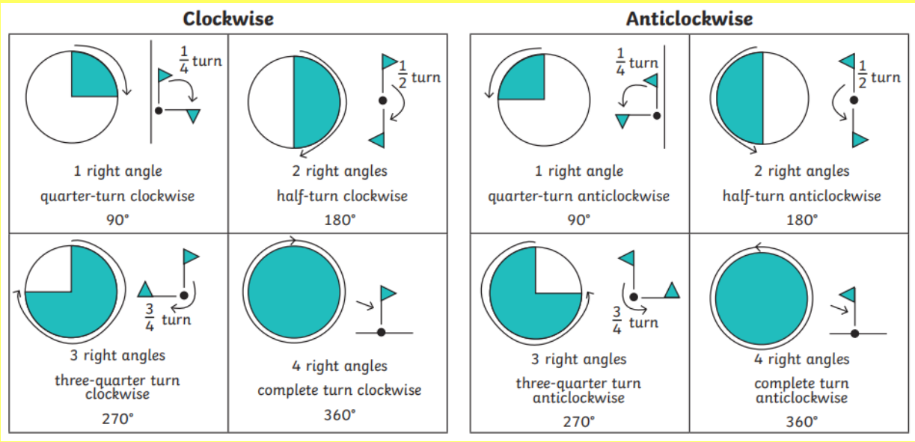
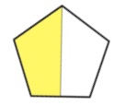
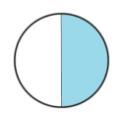




Angles as turns
Quarter turn | Half turn | Three quarter turn | Full turn
90º | 180º | 270º | 360º
 | Example 10 – I do… | Example 11 – We do… | Example 12 – You do…
Steps | The shape below has turned one quarter turn clockwise. Draw the new shape below. | The shape below has turned half turn anticlockwise. Draw the new shape below. | The shape below has turned three quarter turn anticlockwise. Draw the new shape below.
1) Determine how many degrees the shape has turned. 2) Carry out the turn and draw the new shape.

Slide 13
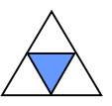

Independent Practice
Question 10. Tick the correct answer for each turn:
 | Original | Turn | Tick the correct answer:
a) |  | Half turn clockwise
b) |  | Quarter turn anti-clockwise
c) |  | Quarter turn clockwise
d) |  | Three quarter turn clockwise
e) |  | Half turn anti-clockwise
f) |  | Quarter turn anti-clockwise
g) |  | Three quarter turn clockwise
h) |  | Full turn anti-clockwise

Slide 14
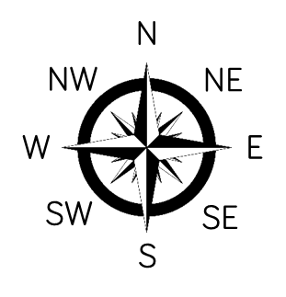






 | Example 13 – I do… | Example 14 – We do… | Example 15 – You do…
Steps | Sam starts by facing North. She turns clockwise to face West. How many degrees has she turned through? | Sam starts by facing East. She makes a quarter turn clockwise. Where is she now facing? | Sam starts by facing West. She turns anticlockwise to face East. How many degrees has she turned through?
1) Use your knowledge of how much of a full turn North, East, South and West are to answer these questions.
South
Independent Practice
Question 11. Answer the following questions:
a) The arrow on a spinner points North. The spinner turns clockwise to point East. How many degrees has the spinner turned? | b) The arrow on a spinner points North. The spinner turns anti-clockwise to point East. How many degrees has the spinner turned?
c) Harry starts by facing East. He makes a quarter turn anti-clockwise. Where is he now facing? | d) Harry starts by facing South. He makes a half turn clockwise. Where is he now facing?
e) Mustafa starts by facing South. He turns anti-clockwise through 270°. Which direction is he now facing? | f) Mustafa starts by facing West. He turns clockwise through 90°. Which direction is he now facing?
g) The arrow on a spinner points North. The spinner turns clockwise to point West. How many degrees has the spinner turned? | h) The arrow on a spinner points North. The spinner turns anti-clockwise to point West. How many degrees has the spinner turned?
North
West
West
North

Slide 15
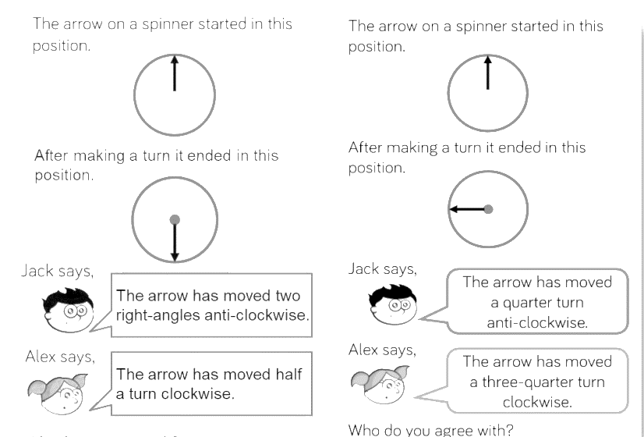
Question 12. The arrow on a spinner started in this position: After making a turn it ended in this position: Jack says “The arrow has moved two right-angles anti-clockwise.” Alex says “The arrow has moved half a turn clockwise”. Who do you agree with – Jack, Alex, both of them or neither of them? You must explain your answer.
Both of them. A half turn is the same as two right angles, which is 180 degrees. When turning 180 degrees, the direction doesn’t matter, as you end up in the same place.
Question 13. The arrow on a spinner started in this position: After making a turn it ended in this position: Jack says “The arrow has moved a quarter turn anti-clockwise.” Alex says “The arrow has moved a three-quarter turn clockwise”. Who do you agree with – Jack, Alex, both of them or neither of them? You must explain your answer.
Both of them. A quarter turn anti-clockwise is the same as a three-quarter turn clockwise.

Slide 16
Question 14. A ship is sailing North. It turns to face east. Mo and Rosie are discussing how far the ship has turned. Mo says “I think the ship has turned one quarter clockwise.” Rosie says “I think the ship has turned 270º”. Who do you agree with – Mo, Rosie, both of them or neither of them? You must explain your answer.
Mo is definitely correct, but Rosie could be correct if she meant that the ship was turning 270 degrees anti-clockwise.
Question 15. Me and my friend start in the same position. If I make a quarter turn anti-clockwise and my friend makes a half turn clockwise, will we end in the same position? You must explain your answer.
No. A quarter turn anti-clockwise is the same as three quarters clockwise.
Question 16. I want to make a whole turn in my gymnastics jump. How many quarters do I need to turn?
Four
Question 17. Asif is facing East. He turns anticlockwise through 540°. Which direction is he now facing?
540 degrees = 1 full turn and a half turn. Asif would now be facing West.

Slide 17
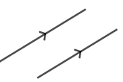
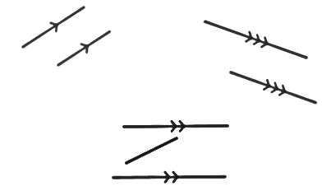








Parallel and Perpendicular Lines
Definition
Characteristics
Lines that are the same distance apart along their whole length.
Parallel lines never meet.
Shown by placing arrows on the lines that are parallel:
Parallel Lines
Examples
Non - Examples
 | Example 16 – I do… | Example 17 – We do… | Example 18 – You do…
Steps | Write down the lines that are parallel in the shape below. | Write down the lines that are parallel in the shape below. | Write down the lines that are parallel in the shape below.
1) Identify the pair(s) of lines that are parallel. 2) Describe them using correct line notation.
CD and AB
AB and ER
BE and AR
AB and DC
AD and BC
Independent Practice
Question 18. Write down the lines that are parallel, if there are any, in the following shapes:
a) | b)
AZ and FW
FZ and AW
HI and JK

Slide 18





Question 18 continued.
c) | d)
e) | f)
g) | h)
i) | j)
k) | l)
None
None
TO and RQ
OP and RS
PQ and ST
AB and CD
AC and BD
A
B
AB and EF
BC and FG
DE and AH
CD and GH
H
C
None
G
D
F
E
Z
None
AB and ED
W
Y
X
W
L
None
IL and JK
IJ and KL
U
V
I
K
S
T
J

Slide 19







Definition
Characteristics
Two lines that meet or intersect each other at right angles.
Can be shown with this symbol
Perpendicular Lines
Examples
Non - Examples
 | Example 19 – I do… | Example 20 – We do… | Example 21 – You do…
Steps | Write down the lines that are perpendicular in the shape below. | Write down the lines that are perpendicular in the shape below. | Write down the lines that are perpendicular in the shape below.
1) Identify the pair(s) of lines that are perpendicular. 2) Describe them using correct line notation.
F
G
M
O
S
P
R
I
H
N
Q
FG and FI
FG and GH
HI and FI
HI and GH
MO and NO
RS and SP
RS and QR
PQ and PS
PQ and QR
Independent Practice
Question 19. Write down the lines that are perpendicular, if there are any, in the following shapes:
a) | b)
LM and MN
LM and LO
NO and LO
NO and MN
A
AB and BC
L
M
O
N
B
C

Slide 20






Question 19 continued.
c) | d)
e) | f)
g) | h)
i) | j)
k) | l)
C
F
W
Z
None
None
D
E
X
Y
J
K
JK and KL
JK and JM
LM and KL
LM and JM
N
None
M
L
O
P
S
U
V
R
Z
W
None
RQ and QT
Q
T
Y
X
H
A
AH and AB
AH and GH
AB and BC
DE and EF
EF and FG
FG and GH
K
KL and JK
KL and LM
IN and IJ
IN and MN
MN and LM
B
I
L
C
J
D
E
N
G
F
M
P
Q
W
None
S
SW and ST
ST and VW
O
V
T
U
R

Slide 21


Mixed Practice
Question 20. Complete the following table:
 | Shape | Shape Name | How many pairs of parallel lines? | How many pairs of perpendicular lines?
a) |  | Square | 2 | 4
b) |  | Rectangle | Two pairs of parallel lines | 4
c) |  | Parallelogram | 2 | None
d) |  | Parallelogram | 2 | No perpendicular lines
e) |  | Trapezium | 1 | None
f) |  | Kite | None | 2
Question 21. Satkiran says the lines can’t be perpendicular because they don’t cross. Do you agree? You must explain your answer.
Satkiran could be wrong. If you extend the lines, they might meet at a right angle. Without drawing this and measuring, we are unable to tell.

Slide 22


Question 22.
a) Label angle AED on the diagram.
b) Write down the name of the line segment that is perpendicular to BC.
AB
Question 23. For each question, write the relationship between the line segments indicated by the arrows (parallel/perpendicular).
a) | b) | c)
__________________ | __________________ | __________________
d) | e) | f)
__________________ | __________________ | __________________
Perpendicular
Parallel
Perpendicular
Parallel
Perpendicular
Parallel

Slide 23



Question 23 continued.
g) | h) | i)
__________________ | __________________ | __________________
j) | k) | l)
__________________ | __________________ | __________________
Parallel
Parallel
Perpendicular
Parallel
Parallel
Perpendicular
Question 24. Complete the sentences below:
a) | b)
Line 1 is parallel to line __________ . Line 3 is _______________ to line 2. | Line 1 is _____________ to line 4 . Line 3 is parallel to line ____________.
c) | d)
Line 7 is parallel to line _______ and line ______. Line 4 is ___________ to line 6 and __________ to line 1. | Line 3 is perpendicular to line _______ and to line ______. Line 2 is ___________ to line 6 and __________ to line 5.
2
perpendicular
perpendicular
1
1
3
1
parallel
perpendicular
4
perpendicular
parallel

Slide 24





Skills Check
What type of angle is shown below?
This shape contains four _______ angles.
This shape has 4 interior angles. How many of them are obtuse?
An angle measures 212º. This means it is…
Which of the following is a correct way to describe the marked angle?
A small angle
An acute angle
An obtuse angle
A right angle
Obtuse
Acute
Reflex
Right
0
1
2
3
Obtuse
Acute
Reflex
A right angle
PQR
PQRS
Q
QR

Slide 25


Skills Check
How many degrees are there in three-quarters of a turn?
Line segments AD and CF are:
75º
90º
180º
270º
Perpendicular
Non-intersecting
Parallel
None of the above

